Slide 1
Software Construction Laboratory CS35L – Lab 1
Course Webpage: https://web.cs.ucla.edu/classes/fall18/cs35L/index.html
TA: Zhiyi Zhang
Email: zhiyi@cs.ucla.edu
Webpage: https://zhiyi-zhang.com

Slide 2
Session 9-2
GPG
Key Management and MITM attack
Review git, diff, patch for assignment 9

Slide 3
Before We Start
Please submit your slides + report to assignment 10 for Lab 1 on CCLE
We will start reviewing previous slides for your final
Final Exam:
Monday, December 10, 2018 3:00 PM - 6:00 PM BOELTER 3760

Slide 4
GPG

Slide 5
What is GPG?
The GNU Privacy Guard
Allow users to encrypt the data and communications
Allow users to sign the data and communications
Provide a versatile key management system
Website:
https://gnupg.org/

Slide 6
Don’t Have gpg Installed?
On Ubuntu, Debian:
apt-get update
apt-get install gnupg
Website to download:
https://www.gnupg.org/download/index.html

Slide 7
Generate a Key for yourself
gpg --gen-key
This will take you through a few questions that will configure your keys
Name, email address
Etc.
gpg --list-keys
This will list the keys you have
Pub: public key; Uid: user id; Sub: subordinate key
SC: Signing ; E: Encryption

Slide 8
Use gpg to Sign/Verify
gpg -s -a
This will generate a signature in ASCII
read the manual to learn -s and -a
gpg --verify
This will verify a signature
read the manual to learn --verify

Slide 9
Use gpg to Encrypt/Decrypt
gpg -e -a -r [recipient's email]
This will encrypt the message using recipient’s public key
read the manual to learn -e, -a, and -r
gpg -d
This will decrypt the message using one’s own private key

Slide 10
Key Management and MITM attack

Slide 11
Key Management
Key tampering is a major security weakness with public-key cryptography
Ensure not just the integrity of your keyrings but the integrity of other users' keyrings as well

Slide 12
Man-In-The-Middle Attack: An Example
Alice and Bob has an encryption connection: Alice uses Bob’s public key to encrypt the messages and sends to Bob
Alice has installed Bob’s public key PubKey-B.
Cathy wants to monitor the messages that Alice sends to Bob
1. Cathy creates a new public/private keypair PubKey-C and PrvKey-C
2. Cathy replaces Alice’s copy of Bob’s public key with PubKey-C
3. Cathy receives Alice’s message encrypted by PubKey-C, decrypts the message with PrvKey-C, re-encrypt the message using PubKey-B, and sends it to Bob.

Slide 13
Key Management with gpg
With pgp, user can
View one’s own keypairs and view trusted parties’ keypairs
Check key integrity
How one’s public key is signed
Add and remove keypairs
Revoke a key (e.g., when the key is compromised)
Change a key’s expiration time
FYI:
https://www.gnupg.org/gph/en/manual/c235.html

Slide 14
Review git, diff, patch for assignment 9

Slide 15
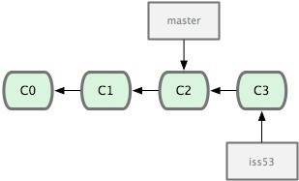
Terminologies in Git
Head
Refers to a commit object
There can be more than one heads in a repo
HEAD
Refers to the current active head
Branch
Refers to a head and its entire set of ancestor commits
Master Branch
Default branch
Detached HEAD
If a commit is not pointed to by a branch

Slide 16
Initialize a Git Repo and Add a Commit
git init
Creates an empty git repo
Creates a .git sub directory in the current dir and contains all the information of the this repo
git add .
Stage your changes
A must before a commit
git commit
Commit your staged changes to the repo and create a git commit
Commit message to let yourself/others to know the purpose and other information of your change

Slide 17
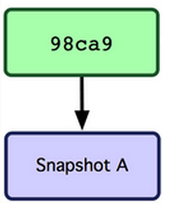
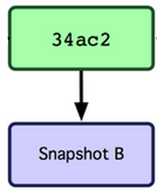
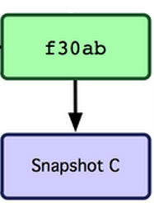
When Commit on a Branch
master

Slide 18
Get Repo From an Existing Repo
Obtain a repo from a web-based hosting service, e.g., GitHub.
git clone
Create a copy of an existing repository

Slide 19
Be Aware of Your Local Changes
git status
Show your modified files
Whether your changes have been staged or not
git diff
Show changes we made compared to the current commit and staged files
git diff HEAD
Show changes we made compared to the HEAD commit

Slide 20
Controlling Version with Branch and Tags
git checkout
Jump to the specified commit or branch or tag
Can also be used to reset the changes
git branch, git checkout -b
Create a new branch on the current commit or specified commit
git tag
Create a tag to the current commit

Slide 21
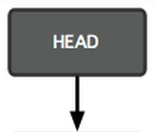
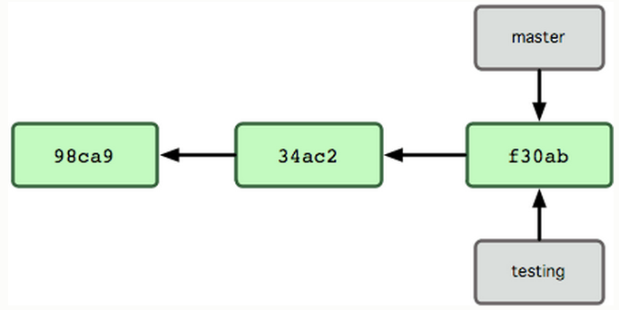
When Checkout to another Branch
git checkout testing

Slide 22
Integrating Changes
Needed when you want to integrate the changes from multiple branches
Two main ways
Merge
simple and straightforward
merge two branches into one
Rebase (recommended)
much cleaner
apply one branch’s changes onto the other branch
Some other ways, e.g., cherry-pick

